Slide 1
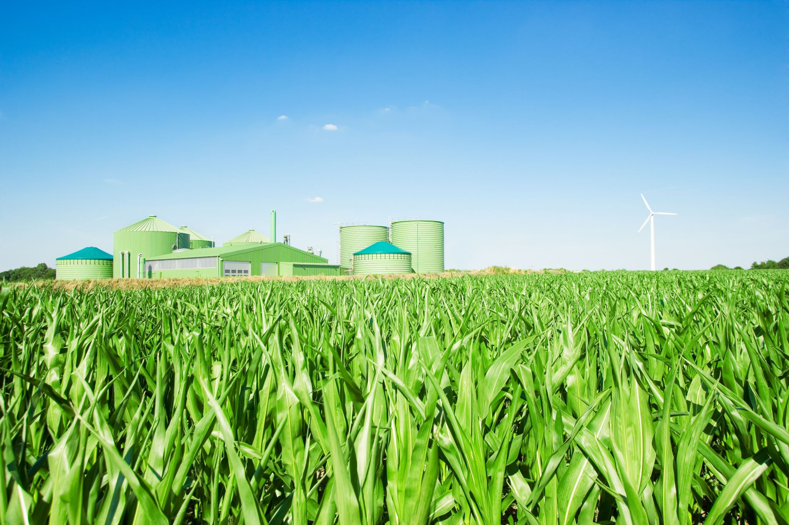
AI and IoT Based Smart Irrigation System for Water-Efficient Crop Production
Presented by: Sambo Tshepang

Slide 2
INTRODUCTION
Agriculture uses 70% of global freshwater
Inefficient irrigation leads to water waste, lower yields, and higher costs
Climate change intensifies water scarcity
Our solution: AI + IoT for precise, data-driven irrigation

Slide 3
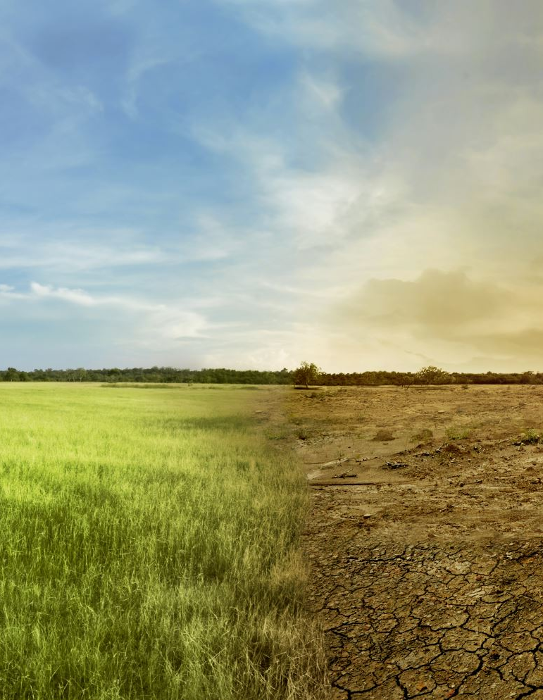
PROBLEM STATEMENT
Fixed irrigation schedules → overwatering or underwatering
Negative impacts:
  Reduced crop yields
  Soil degradation
  Higher production costs
  Fertilizer runoff

Slide 4

PROPOSED SOLUTION
Integrates historical & real-time data:
  Rainfall, soil properties, crop needs, weather forecasts
Uses AI analytics to:
  Calculate precise water requirements
Results delivered via computer interface to farmers and planners

Slide 5
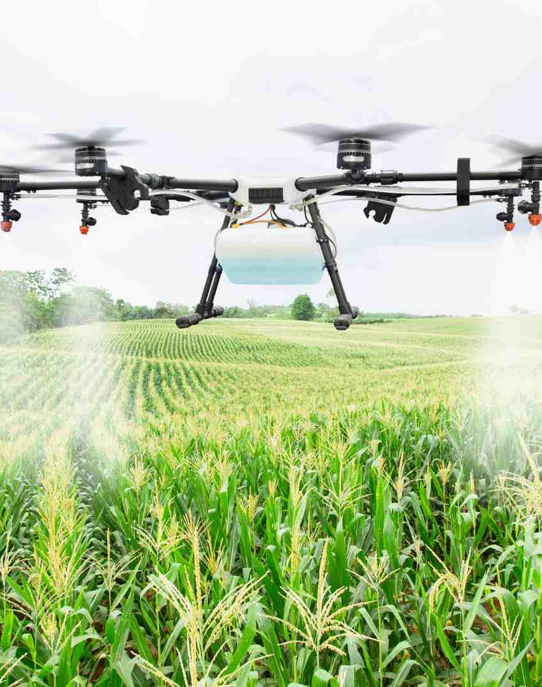
AIM &OBJECTIVES
Aim:
To develop an AI and IoT-driven smart irrigation system that optimizes water use, improves crop yields, and supports sustainable farming.
Objectives:
Use IoT sensors for real-time monitoring of soil moisture and weather
Achieve at least 30% reduction in agricultural water use
Provide farmers with clear, actionable insights via a digital interface
This Photo by Unknown Author is licensed under CC BY

Slide 6

TOOLS & INTEGRATIONS USED
1. HARDWARE SIMULATION
Proteus 8 – Simulated IoT circuits
2. FARMER INTERFACE
Real-time graphs – Moisture trends over time
SMS Alerts – For areas with poor internet
3. API INTEGRATIONS
Weather Data: weatherapi.com

Slide 7
EXPECTED BENEFITS
Economic:
Lower irrigation & energy costs
Increased crop yields & farm profitability
Environmental:
Reduced water wastage
Improved soil health & less nutrient runoff
Social:
Better livelihoods for farmers
Enhanced food security

Slide 8

CONCLUSION
Smart irrigation = smarter farming
Combines AI with IoT for precision, efficiency, and sustainability
Supports water conservation, higher yields, and farmer resilience

Slide 9


